Slide 1
Distributed Systems
Damir Dobric damir.dobric@daenet.com https://developers.de/author/ddobric
daenet Lead Software Architect Microsoft Regional Director & Most Valuable Professional
Blog:
AZURE TRAINING - ADVANCED
Twitter:
https://twitter.com/ddobric

Slide 2
AGENDA
The need for cloud
Distributed Systems
Web Service API styles
Interaction styles
Services and Microservices

Slide 3
Moore's Law
Trend for number of transistors on integrated circuit.
It doubles approximately every two years.
Strongly linked to:
processing speed,
memory capacity,
and even the number and size of pixels in digital cameras.
Impact on nearly every segment of the world economy

Slide 4
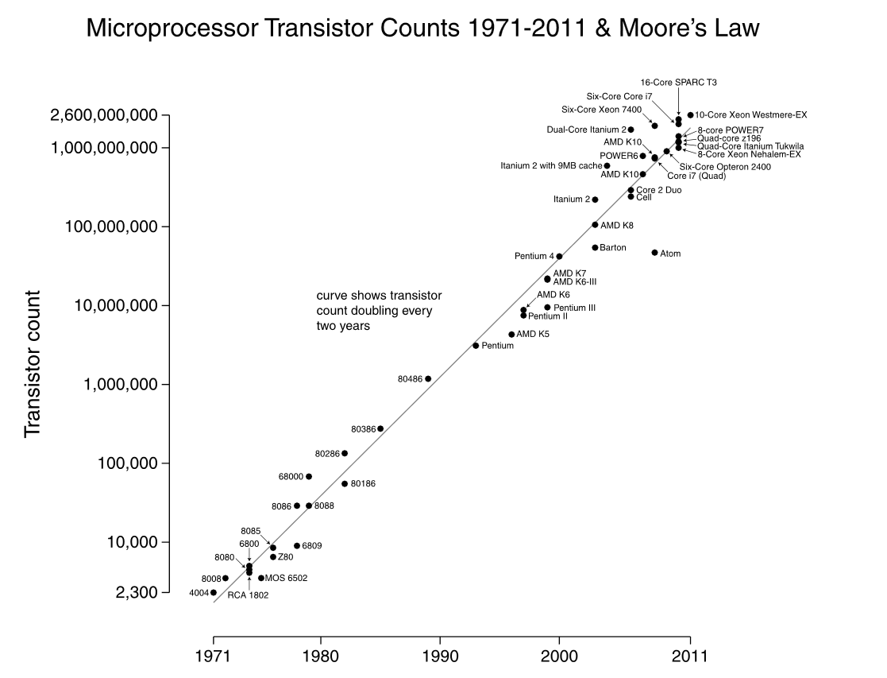
Limit of vertical scale ?

Slide 5
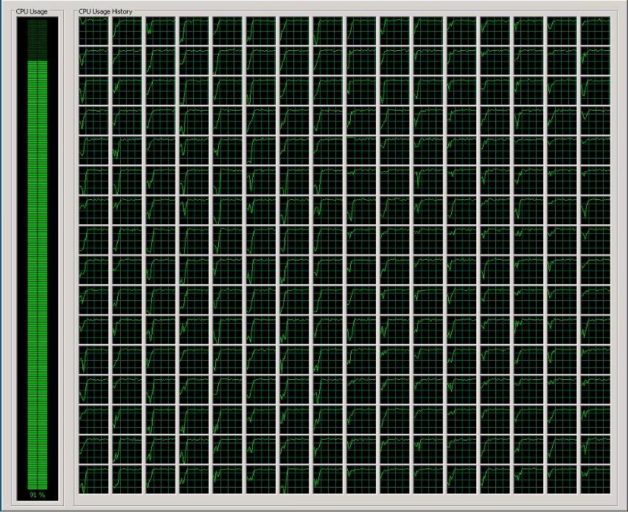
256 Core Processor

Slide 6
Multithreaded => Multicore => Multimachine
A program running on Cloud Platform
Machine I
Machine I
Processor x64 – Core I
Processor x64 – Core II
Processor x64 – Core I
Processor x64 – Core II
Thread 1
Thread 2
Thread 1
Thread 2
Thread 1
Thread 2
Thread 1
Thread 2
Processor x64 – Core III
Processor x64 – Core IV
Processor x64 – Core III
Processor x64 – Core IV
Thread 1
Thread 2
Thread 1
Thread 2
Thread 1
Thread 2
Thread 1
Thread 2
today– tomorrow

Slide 7
What is a Distributed System?
A distributed system is a software system in which components located on networked computers communicate and coordinate their actions by passing messages.^{[1]}

Slide 8
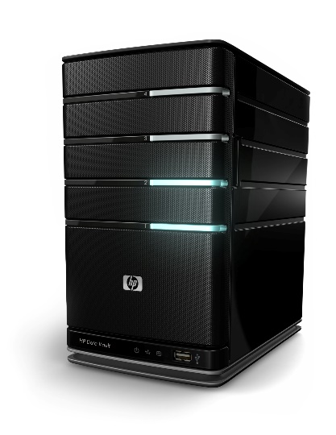

Example
Service3
Service1
Service4
Service2
Service5

Slide 9
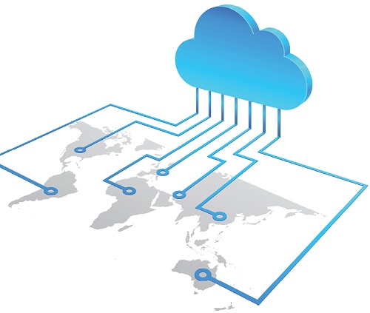
Geographically distributed system

Slide 10
Trivial Distributed System
Interaction:Request/Response
HTML/JavaScript
WebServer
Security:Transport
Style:REST

Slide 11
Trivial Distributed System
Interaction:Request/Response
HTML/JavaScript
WebServer
Security:Transport
Prot:http/https
CLIENT
SERVER

Slide 12
Three-Tire Architecture
FRONT END
BROWSER
RICH CLIENT …
CLOUD
T1
MIDDLE WARE
SERVICES
T2
DATA
DATABASE
T3

Slide 13
None-Trivial Connected System
Thing
Interaction Style?
Thing
Thing
Security?
API Style ?

Slide 14
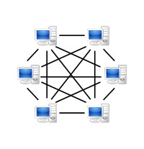
Peer to Peer (P2P)
When all participants play a role of Client and Server.
I.E.: Gaming, Chat Applications
Public IP required.
Connectivity Logic is distributed across participants

Slide 15
Interaction Styles

Slide 16
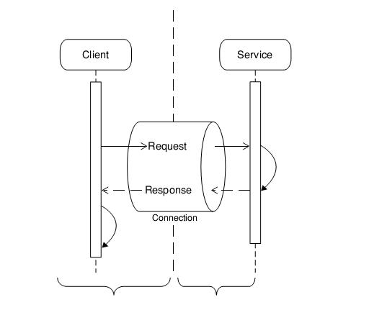
Client Service Interaction Request Response

Slide 17
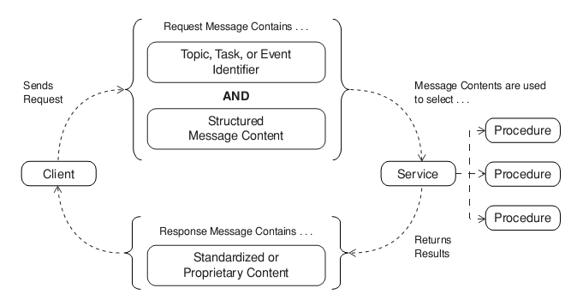
Client Service Interaction Request Acknowledge

Slide 18
Web Service API Styles
RPC-Api-Style
Resource-API-Style
Message-API-Style

Slide 19
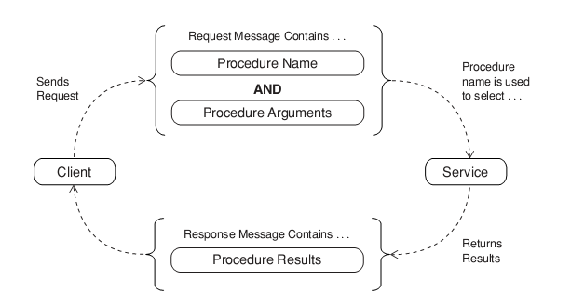
API Style Remote Procedure Call

Slide 20
Exercise: Implement your SOAP Service with WCF
You will learn following:
Create RPC style SOAP Service with WCF
Create Solution in Visual Studio
Create Hello World Service
Create Consumer of the service
Step by Step tutorial:
https://msdn.microsoft.com/en-us/library/ms731758(v=vs.110).aspx

Slide 21
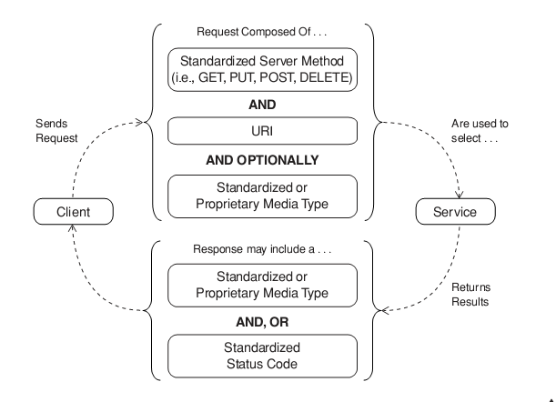
API Style Resource

Slide 22
Exercise: Implement your REST Service
You will learn following:
Create REST style Service with WebApi
Create MVC 5 (.net core) Project with Visual Studio
Create WebApi Controller (your REST service)
Create Consumer with Java Script and jQuery
Step by Step tutorial: https://docs.microsoft.com/en-us/aspnet/core/tutorials/first-web-api

Slide 23
API Style Message

Slide 24
Client-Service Interaction style

Slide 25
Client Service Interaction Request Response

Slide 26
Client Service Interaction Request Acknowledge

Slide 27
Messages, Events and States

Slide 28
Messages, States and Events
m1
S20
S21
Service3
S10
Service1
m1
Service4
m2
S11
e1
Service2
Service5
S30
S31
S40
S41
e1
e1

Slide 29
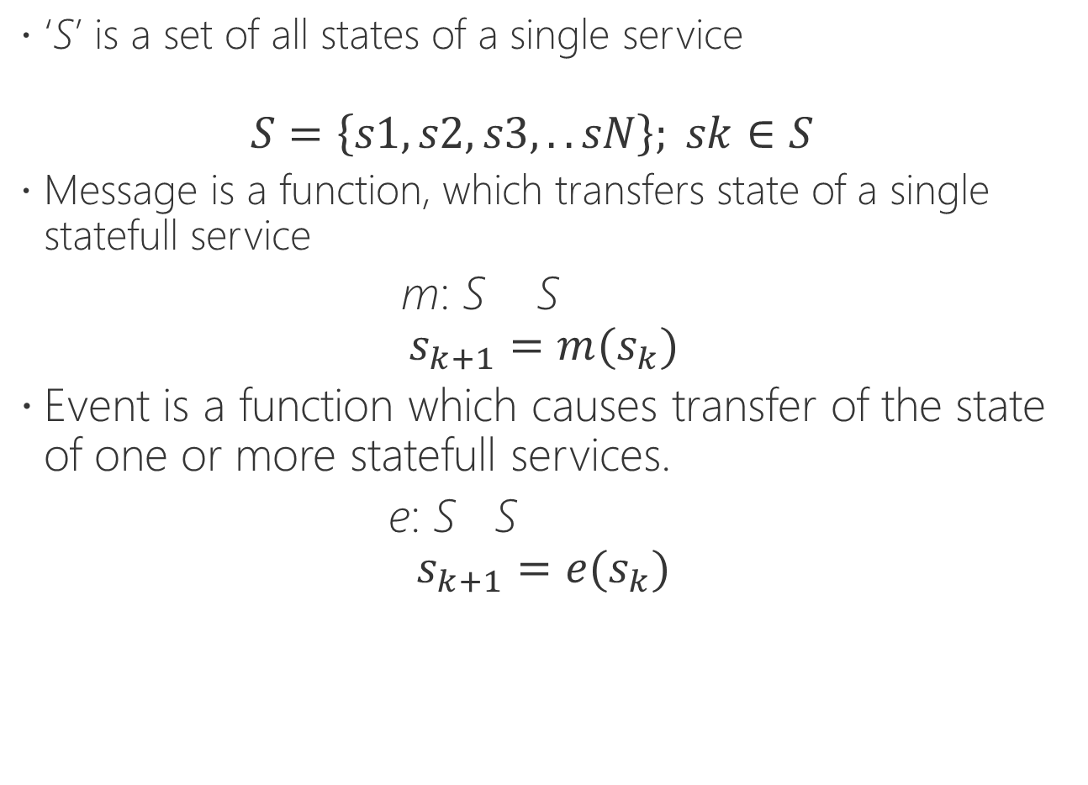
Mathematical representation
‘S’ is a set of all states of a single service $S=\left\{s1, s2,s3,..sN\right\}; sk∈S$
Message is a function, which transfers state of a single statefull service
m: S S $$s_{k+1}=m(s_{k})$$
Event is a function which causes transfer of the state of one or more statefull services.
e: S S
$$s_{k+1}=e(s_{k})$$

Slide 30
Messages, States and Events
m1
S20
S21
Service3
S10
Service1
m1
Service4
m2
S11
e1
Service2
Service5
S30
S31
S40
S41
e1
e1

Slide 31

Mathematical representation
‘S’ is a set of all states of a single service $S=\left\{s1, s2,s3,..sN\right\}; sk∈S$
Message is a function, which transfers state of a single statefull service
m: S S $$s_{k+1}=m(s_{k})$$
Event is a function which causes transfer of the state of one or more statefull services.
e: S S
$$s_{k+1}=e(s_{k})$$

Slide 32
Services and Microservices

Slide 33
Architecture Styles
Client/Server
Peer-To-Peer
Three-tier, N-tier
Microservices
. . .

Slide 34
Service Oriented Architecture
“Service orientation is a means for integrating across diverse systems”
System 1
System 2
System 3

Slide 35

Microservices Approach
“Microservices is an Architektur Style to design a single (usually complex) application as a group of small (micro) services,
which are independend in
development, technology, scale and deployment“
All services build ONE system.
Service 1
Service 3
Service 2
Notes:
“Microservices ist ein (neuer) Architektur Style eine Anwendung als Gruppe von kleinen (micro), voneinander in Entwicklung und Deployment isolierten, Services zu entwickeln.“

Slide 36
Scale Cube
X = Loadbalancing scale
Y = Functional Scale
Z = Data Partitioning

Slide 37
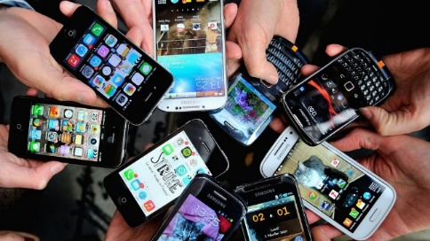
X-Scale (Loadbalancing)
Share traffic across multiple nodes is “easy”.
Node1
Node 2
. . .
Node N
DB
Relational DB scales vertically only. Horizontal scale is very difficult.

Slide 38
Z-Scale (Data Partitioning)
Tire 1
Customers 10001-…
Customers 0-10000
DB1
DB2
Tire 1
Tenant 1
Tenant 2
DB1
DB2

Slide 39
Microservice = Y-Scale
Microservice
Microservice
Purchasing
Order Tracking
. . .
Feature N
DB
DB
. . .
DB

Slide 40
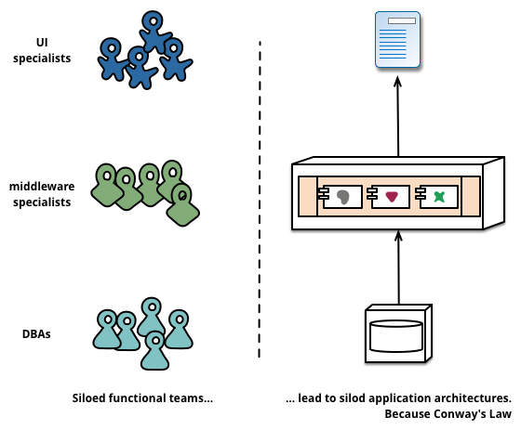
Melvin Conway’s Low
“Organizations which design systems ... are constrained to produce designs which are copies of the communication structures of these organizations”
Wikipedia, James Lewis + Martin Fowler

Slide 41
When to use Microservices?
If Microservices should be developed in different technologies
If Microservices requires different scale
If Microservices are developed, deployed and operated independently
If different versions of Microservices should be used

Slide 42
API Gateway
These are Microservices. They are typically used inside of enterprise boundary.
ApiGateway
These is not a Microservice. It is publicly accessable service used for integration (SOA), which consumes and orchestrates Microservices

Slide 43
Hexagonal Architecture
EDIfact Adapter
AMQP Adapter
SOAP Adapter
REST Adapter
A
A
A
A
Ports are logical artefacts.
Adapters are physical implementation of ports.
Port Layer
Microservice

